Slide 1
Having Kids Business Plan
Notes:
KIDS DESERVE A FAIR
AND SUSTAINABLE WORLD
Fair Start family planning is the best way to get there.

Slide 2
Notes:
Inequality is rising globally, threatening human rights and democracy.
Nearly 40% of kids in the U.S. live in or near poverty with the UN calling it, “the most unequal society in the developed world.” 387 million children live in extreme poverty worldwide.
The climate crisis and sixth mass exinction threaten all life.
By 2050, humans will need 100% more of the planet’s total biocapacity.
Why are all of these things in peril?

Slide 3
Notes:
Almost 50% of pregnancies are unplanned.
The UN and COP Conference are focused on industrial emisions and insufficient policies. They are ingoring the most effective solution to the crises we face.
Without action for better family planning, we cannot achieve the UN’s Sutainable Development Goals, or satisfy the Children’s Right Convention.

Slide 4
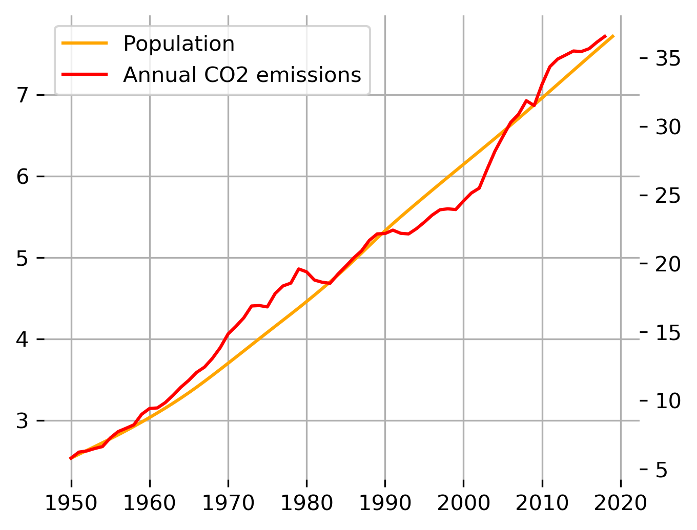
The Problem is Unsustainable Growth

Slide 5
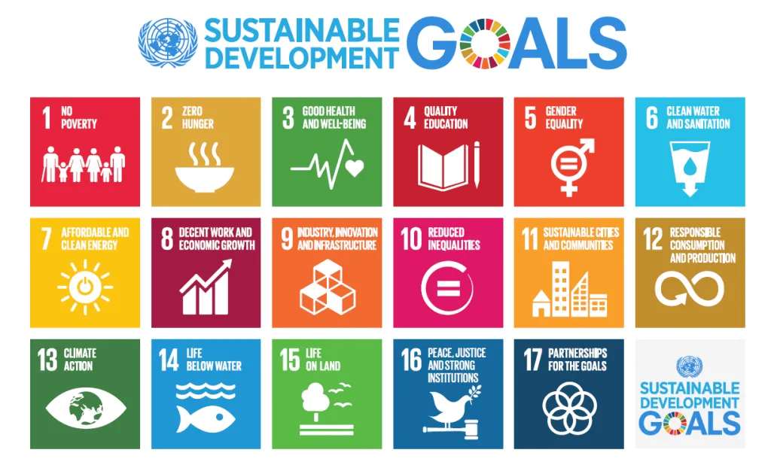
“Development that meets the needs of the present without compromising the ability of future generations to meet their own needs."
-International Institute for Sustainable Development
The target is well-defined

Slide 6
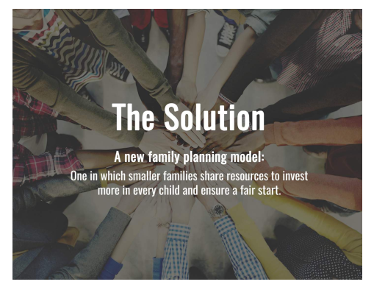
Notes:
The Solution
A new family planning model:
One in which smaller families share resources to invest more in every child and ensure a fair start.

Slide 7
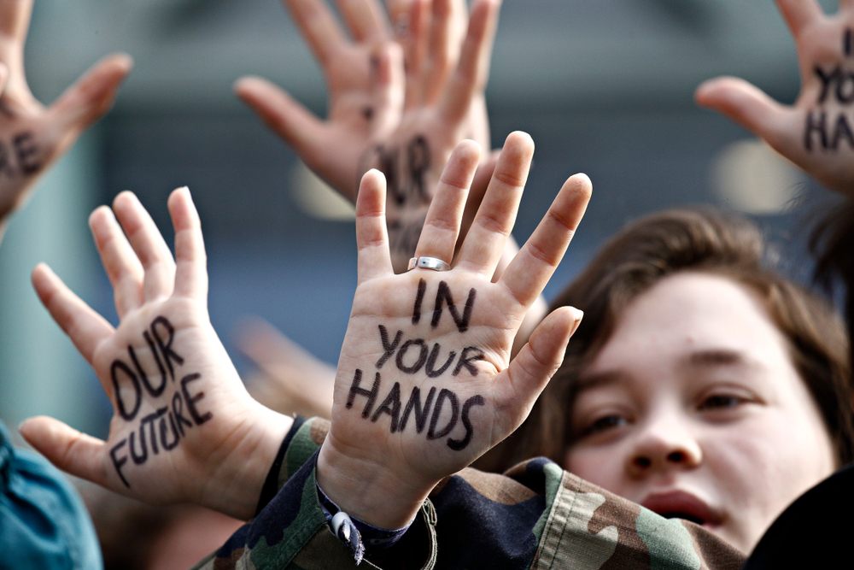
The Solution is in Our Hands

Slide 8
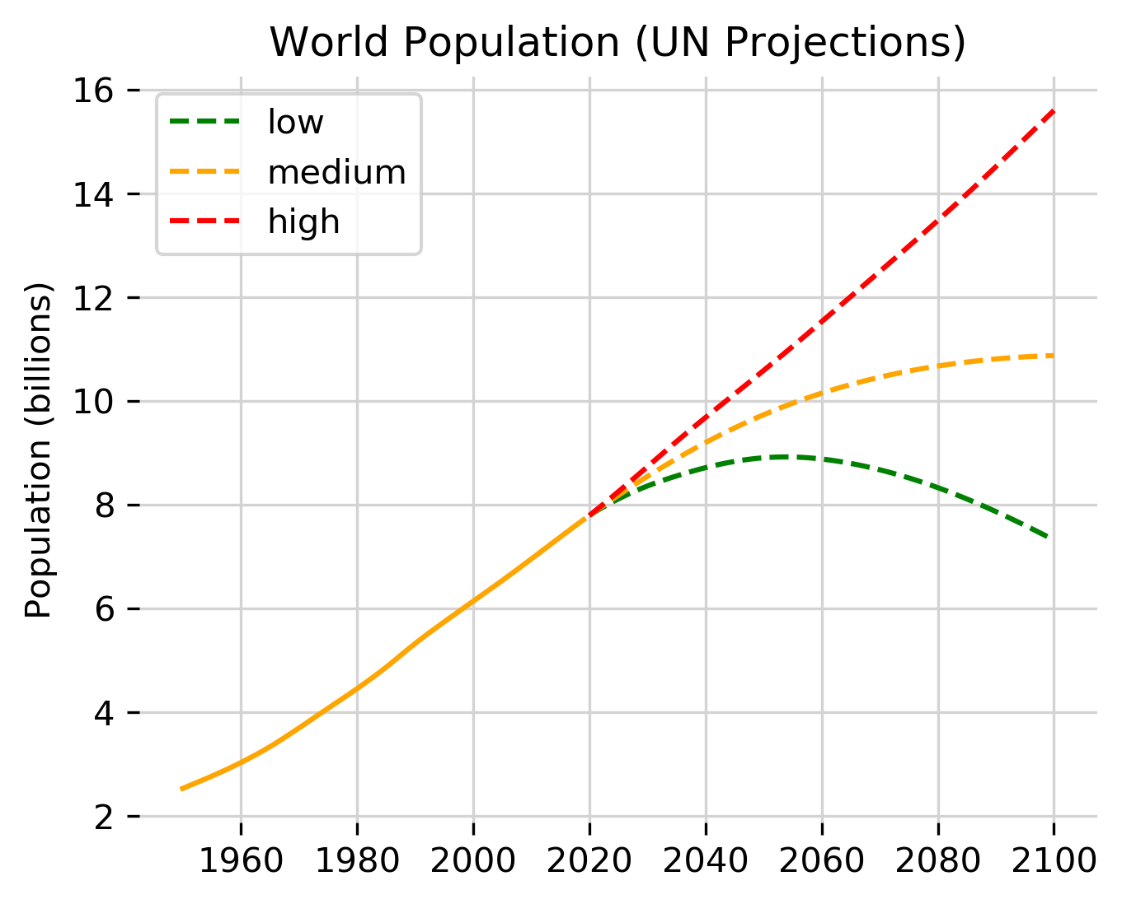
World Population will increase to 11 billion by 2100 if we do nothing, threatening our survival.
The Solution is Green
“Population growth and economic (consumption) growth are the two main causes of global warming.”

Slide 9
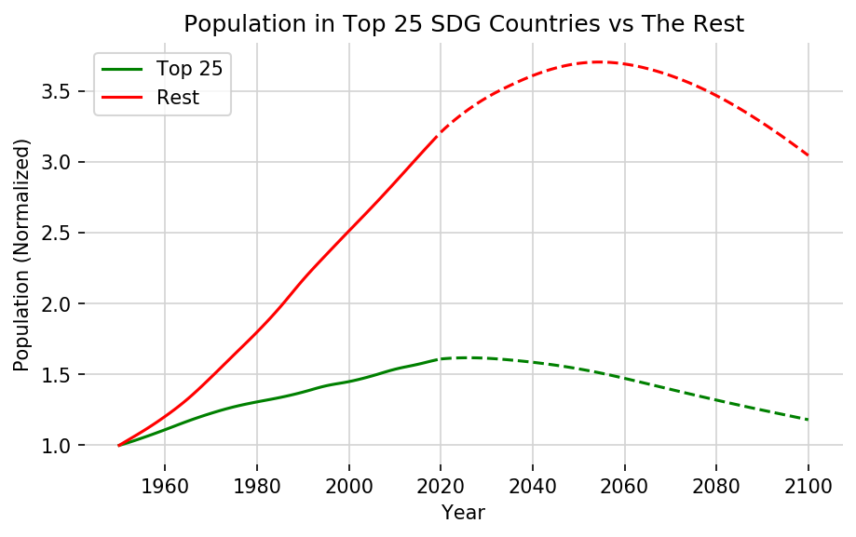
Countries with lower Population Growth are Developing More Sustainably
Flatten the Curve Before it is too late
Total Population of the Top 25 Sustainably Developing Countries in 2015 vs the rest.

Slide 10
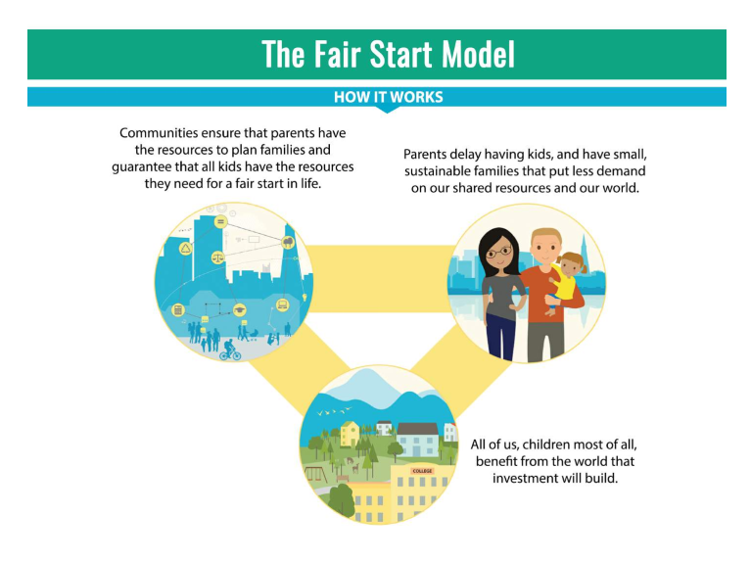
Notes:
The Fair Start Model
How it works
Communities ensure that parents have the resources to plan families and guarantee that all kids have the resources they need for a fair start in life.
Parents delay having kids, and have small, sustainable families that put less demand on our shared resources and our world.
All of us, children most of all, benefit from the world that investment will build.

Slide 11
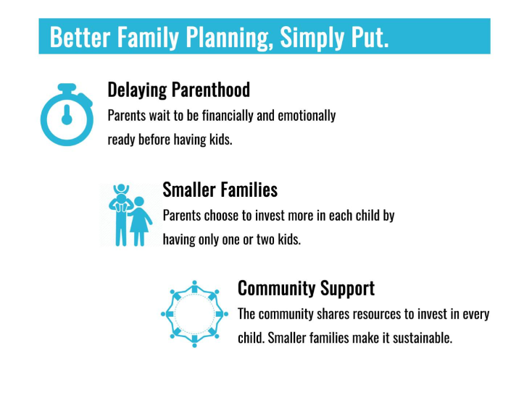
Notes:
Better Family Planning, Simply Put.
Delaying Parenthood
Parents wait to be financially and emotionally ready before having kids.
Smaller Families
Parents choose to invest more in each child by having only one or two kids.
Community Support
The community shares resources to invest in every child. Smaller families make it sustainable.

Slide 12
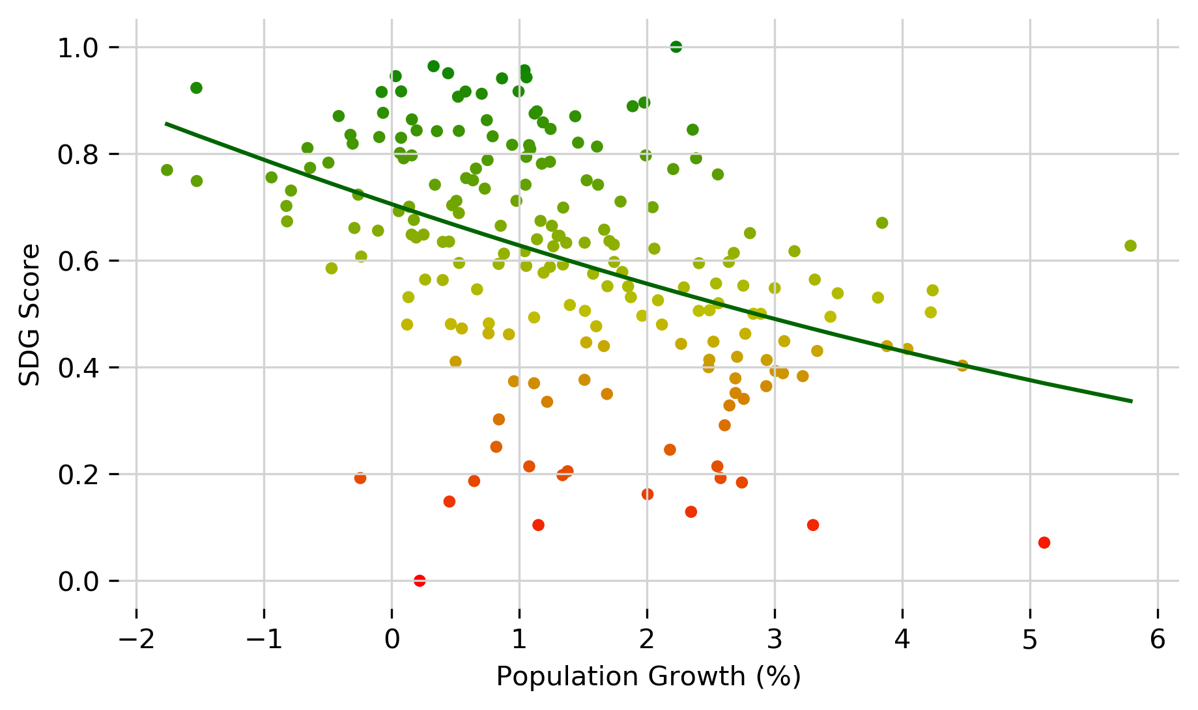
Planners are Achievers

Slide 13
Delayed Parenthood
HavingKids.org
Guaranteed Minimum Income (GMI)
Reduced Inequality
Better Family Planning
Lower Population Growth & SDGs
Equal Opportunity & Education For all Kids
Fair Start
Fertility Delay Incentives to Planning

Slide 14
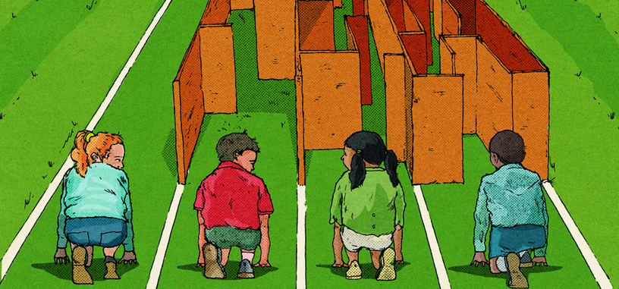
How much do we owe?
Close the Gap
Individual Action
Private Funds
Collective
Action
Tax Transfers
“diversity, equity & inclusivity”

Slide 15
Human Lives ⇐⇒ Animal Lives
Excess Population Growth
The Animal Mortality Impact Calculator
Biodiversity
loss
Animal Mortality

Slide 16
HavingKids’ impact
20 TIMES: Having a smaller family is 20 times more effective than behavioral change
13%: The return on investment for early childhood programs
1 MILLION SPECIES face extinction thanks to human activity, the U.N. reports.

Slide 17
HavingKids’
Research & Collaborations
Dillard, C. J. (2007). Rethinking the procreative right. Yale Hum. Rts. & Dev. LJ, 10, 1.
Conly, S. (2016). One child: Do we have a right to more?. Oxford University Press, USA.
Analysis with collaboration with University of Oxford

Slide 18
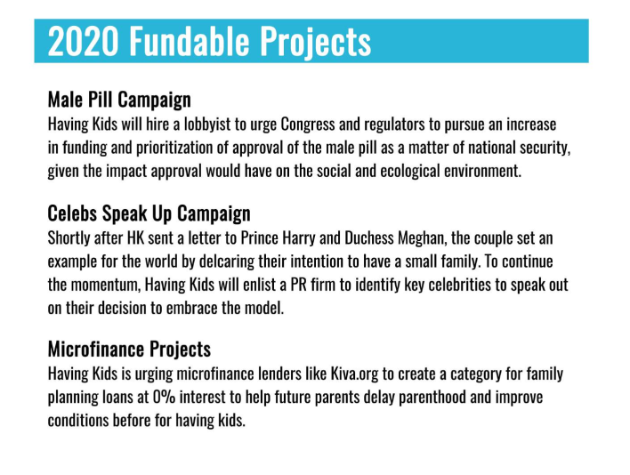
Fundable Projects 2021
Notes:
Male Pill Campaign
Having Kids will hire a lobbyist to urge Congress and regulators to pursue an increase in funding and prioritization of approval of the male pill as a matter of national security, given the impact approval would have on the social and ecological environment.
Celebs Speak Up Campaign
Shortly after HK sent a letter to Prince Harry and Duchess Meghan, the couple set an example for the world by delcaring their intention to have a small family. To continue the momentum, Having Kids will enlist a PR firm to identify key celebrities to speak out on their decision to embrace the model.
Microfinance Projects
Having Kids is urging microfinance lenders like Kiva.org to create a category for family planning loans at 0% interest to help future parents delay parenthood and improve conditions before for having kids.

