Slide 1
Survey 2 - Fertility rate and population
Tuesday, September 15, 2020

Slide 2
376
Total Responses
Date Created: Monday, August 24, 2020
Complete Responses: 376

Slide 3
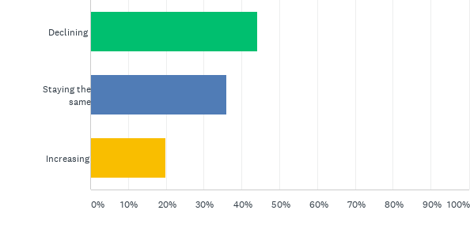
Q1: In the United States, do you think fertility rates are:
Answered: 376 Skipped: 0

Slide 4
Q1: In the United States, do you think fertility rates are:
Answered: 376 Skipped: 0

Slide 5
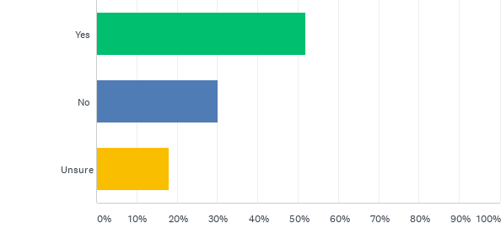
Q2: Do you think that declining fertility rates will lead to a declining population worldwide within your lifetime?
Answered: 376 Skipped: 0

Slide 6
Q2: Do you think that declining fertility rates will lead to a declining population worldwide within your lifetime?
Answered: 376 Skipped: 0

Slide 7
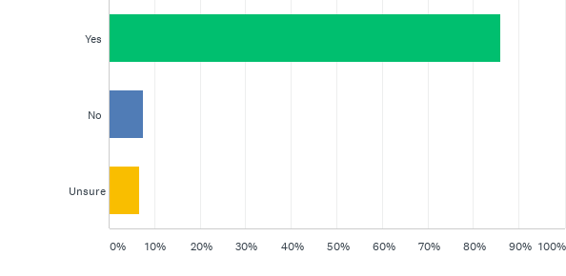
Q3: Do you see a relationship between family size (the number of children a couple decides to have) and human population?
Answered: 376 Skipped: 0

Slide 8
Q3: Do you see a relationship between family size (the number of children a couple decides to have) and human population?
Answered: 376 Skipped: 0

Slide 9
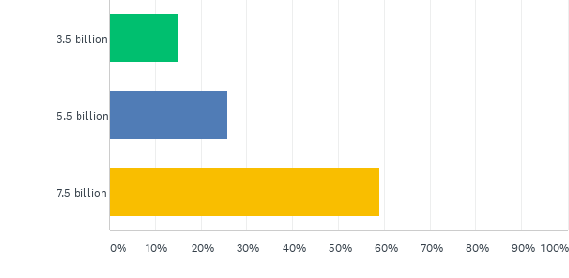
Q4: Which number best reflects the human population at this time?:
Answered: 376 Skipped: 0

Slide 10
Q4: Which number best reflects the human population at this time?:
Answered: 376 Skipped: 0

Slide 11
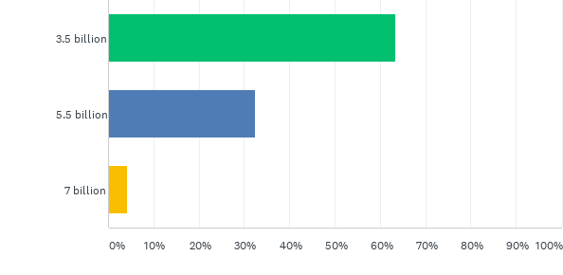
Q5: Which number best reflects the human population in 1970 (50 years ago)?:
Answered: 376 Skipped: 0

Slide 12
Q5: Which number best reflects the human population in 1970 (50 years ago)?:
Answered: 376 Skipped: 0

Slide 13
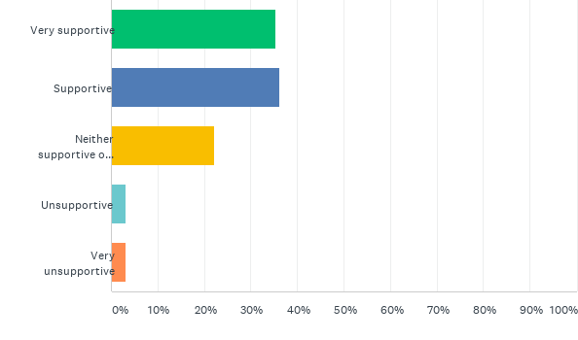
Q6: How supportive would you be of an organization whose mission is to encourage cooperation between prospective parents, and be focused on creating smaller and more equitable families?
Answered: 376 Skipped: 0

Slide 14
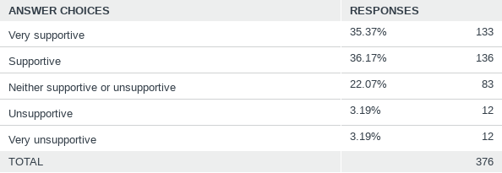
Q6: How supportive would you be of an organization whose mission is to encourage cooperation between prospective parents, and be focused on creating smaller and more equitable families?
Answered: 376 Skipped: 0

